Slide 1
Evolutionary Computing & Cybersecurity
COMP8920-1-R1-2019S
APPLIED ARTIFICIAL INTELLIGENCE IN CYBERSECURITY
By: Mayank Semwal
Vipul Malhotra

Slide 2
OUTLINE:
Data Insights
Typing Speed
Correlation Analysis
Reality of Data and its Limitations
Keystroke Detector Analysis
Manhattan distance
Euclidean distance
Users Set Description: Wolf, Lamb, Sheep and Goat
Biometric Adversary Framework
Initialization
Fitness & Selection
Crossover
Mutation
Termination

Slide 3
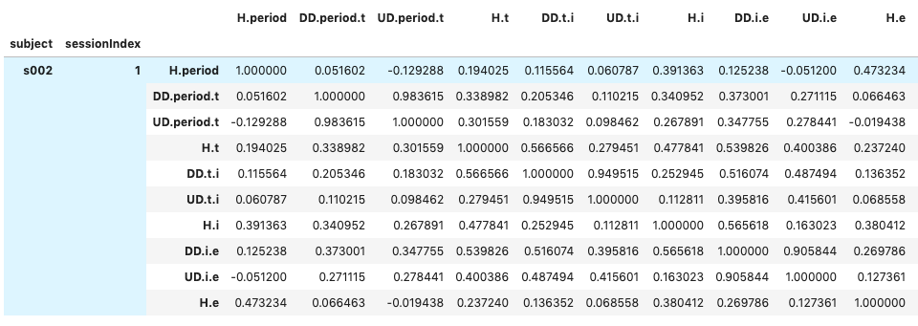
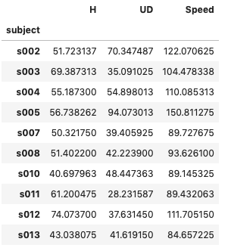
DATA INSIGHTS
Typing Speed :
First, dataset is grouped and summed on the basis of subject and session Index.
Second, combine hold and up-down key values of each subject and session in a single keystroke (31 columns).
Finally, computing speed of each user by cumulating average time of key values of each session.
Correlation Analysis: If h. period key is typed so fast it is observed that user takes time to enter the next key and the correlation value is negative. However, if correlation is close to 1 then both the keys are relative to each other.

Slide 4
DATA INSIGHTS
How Realistic Is the Data ?
Sometimes user’s mood can affect the typing behavior which is not considered in the dataset.
Diversification of data on the basis of gender, age and nationality is not taken into consideration.
Dataset collector has ignored typological errors and because of this user has to retype the password therefore in reality while typing password users definitely make significant errors which may affect the behavior analysis.
Limitations:
Firstly, typing patterns can be inconsistent like cramped muscles and sweaty hands can change a person’s typing pattern.
Low Accuracy: Due to the variations in typing rhythm that caused by external factors such as injury, fatigue, or distraction.
Lower Permanence: Typing pattern of a user gradually changes as can be noticed in each 50 repetitions, maturing typing proficiency can also be a factor of variations in speed of different users, adaptation to input devices, and other environmental factors (geographic implications).

Slide 5
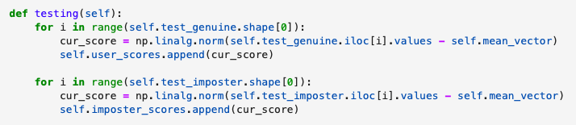
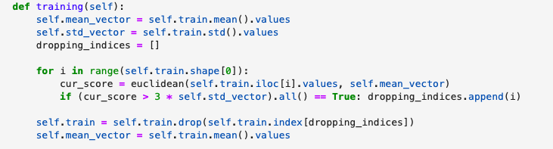
KEYSTROKE DETECTOR ANALYSIS
Steps:
We consider first user as genuine and rest as imposters in which genuine user's first 200-time vectors are used for training and next 200 as test samples.
Next step, detector will take 10 keystroke login samples per user and generate keystroke signature for this user in which imposter set (500 records, 10 per imposter, 50 imposters in all).
In next step, data will be trained and their mean and std vector are calculated and outliers will be removed by taking into account deviations in typing habits.
To reject the outliers first Euclidean and Manhattan distance between training and mean vector is calculated and any vector whose distance is greater than 3 times the standard vector.
Pass the test samples, imposter set and results of training function i.e. mean and std values into testing function, it will calculate the Euclidean and Manhattan distance between test sample and mean vector.

Slide 6
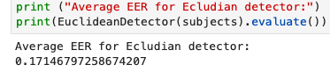
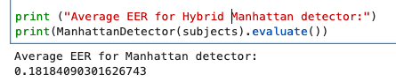
KEYSTROKE DETECTOR ANALYSIS
Having obtained the scores for both kind of samples, genuine and imposter, in lists user scores and imposter scores respectively, we evaluate the equal error rate (EER) for the detector.
Two types of detector we have used: Hybrid Manhattan and Euclidean distance
So accuracy of Euclidean detector is 83% and Manhattan is 82% respectively.

Slide 7
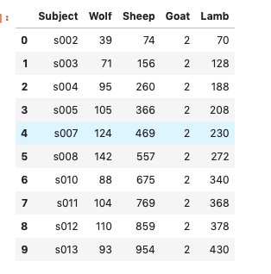
Users Set Description ( Sheep, Wolf, Goat and Lamb)
User Group | Criteria | Description
Sheep | TPR >= 0.85 | If genuine users are able to login correctly (true positive rate must be high)
Goat | Missrate >= 0.85 | User who are prone to false reject or wrongly considered as imposters i.e. miss rates (1-tpr) must be high
Lamb | FAR > 0.45 AND FAR<= 0.85 | If false acceptance rate is low means the genuine users are easily imitated.
Wolf | FAR >=0.85 | If false acceptance rate is high means the imposters are wrongly considered as genuine user.
NOTE: we consider each session of user as the imposter for some other user that is why the value of each user group (sheep, goat, lamb, wolf) is relatively high.

Slide 8
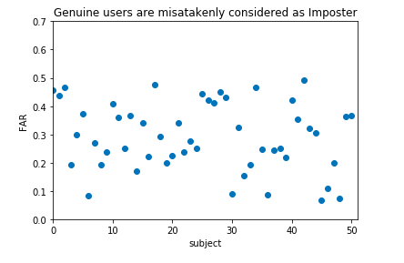
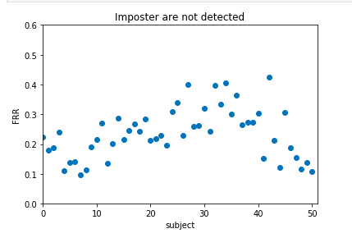
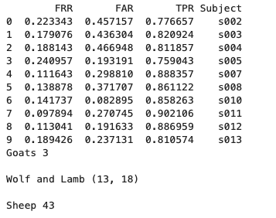
Users Set Description ( Sheep, Wolf, Goat and Lamb)

Slide 9
Biometric Adversary Framework
Initialization: We have created an initial population in the shape of an array of fix size and can be of any desired size from few individuals to many.
Fitness & Selection:Each member of the population is evaluated and we calculate a fitness for each individual. The fitness value is calculated using Euclidian distance.
If Euclidean distance is greater than equal to 0.85, value will be appended to fitness array and will be returned. It is used to select n number of parents (we have considered two parents).
To improve population’s overall fitness. We have considered one parent to be randomly selected from fitness array and other parent randomly from the initial population, the basic idea is to diversify selection of parents but also considering single parent to be selected from the best fitted results.
Crossover: During crossover we create new individuals (known as offspring's) by combining aspects of our selected parents.

Slide 10
Biometric Adversary Framework
The crossover rate is the probability of acceptance to select individuals of next generation which is 0.5(i.e. 50%) in our crossover criteria.
We have used single point cross-over in which parent to the right of that point are swapped between the two parents.
Mutation: To add a little bit randomness into our population genetics because every combination of solution will be different from initial population. We have used a random value generated in each generation ranging from 0 to 0.5 to be added to offspring.
Termination: If mutation result is greater than or equal to maximum from fitness result array (i.e. fitnessArr.max ()) the generation will break and display the set of best mutations in each generation into an array, out of which we will select the maximum two compare with maximum from fitness array.
Goal: The goal is to get mutation results close to the fitness value.

Slide 11
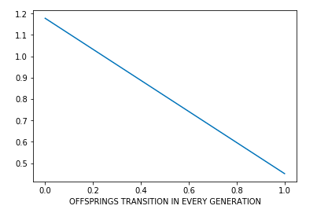
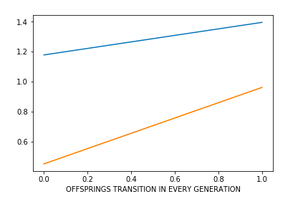
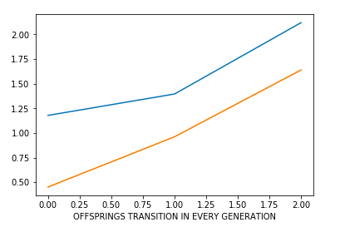
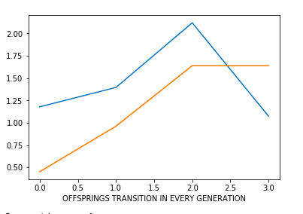
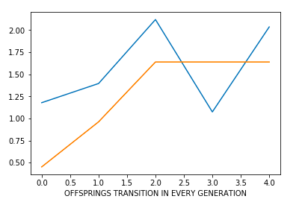
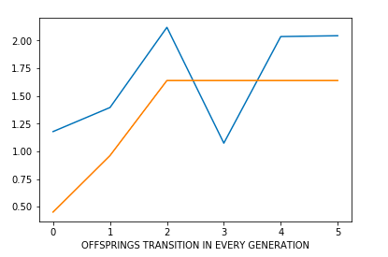
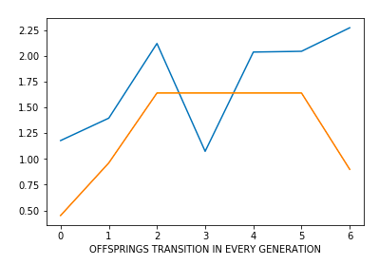
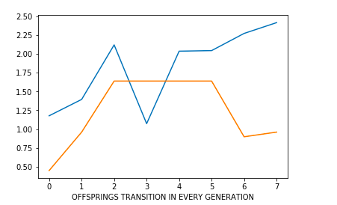
Biometric Adversary Framework – Offspring Mutation Results
Generation 1
Generation 2
Generation 3
Generation 4
Generation 5
Generation 6
Generation 7
Generation 8

Slide 12
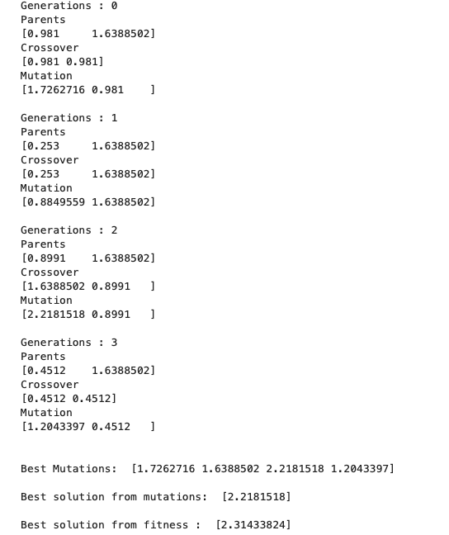
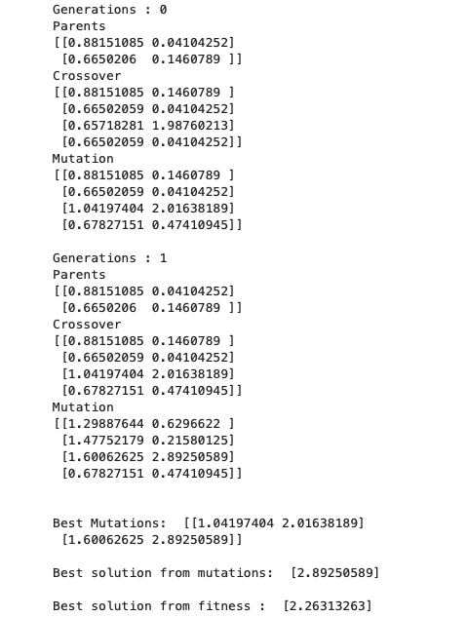
Biometric Adversary Framework

Slide 13
Thank You!
Any Questions?

